Slide 1


IMAGE PROCESSING SYSTEM PROJECT SYNOPSIS of Summer Training Project BACHELOR OF TECHNOLOGY COMPUTER SCIENCE AND ENGINEERING Submitted To Dr. A.P.J. ABDUL KALAM TECHNICAL UNIVERSITY LUCKNOW SUBMITTED BY Name : Harsh Srivastava & Ritik Kapil UNDER THE SUPERVISION OF Dr . Vijay Kumar Dwivedi Assistant Professor UNITED COLLEGE OF ENGINEERING AND RESEARCH , PRAYAGRAJ

Slide 2
ACKNOWLEDGEMENT We would like to express our deep gratitude to our project guide Mr. Vijay Kumar Dwivedi , Assistant Professor, Department of Computer Science and Engineering, for his/her guidance with unsurpassed knowledge and immense encouragement. We are grateful to Dr. Vijay Kumar Dwivedi , Head of the Department, Computer Science and Engineering, for providing us with the required facilities for the completion of the project work. We are very much thankful to the Principal and Management , for their encouragement and cooperation to carry out this work. We express our thanks to all teaching faculty of Department of CSE , whose suggestions during reviews helped us in accomplishment of our project . We would like to thank all non-teaching staff of the Department of CSE , for providing great assistance in accomplishment of our project. We would like to thank our parents, friends, and classmates for their encouragement throughout our project period. At last but not the least, we thank everyone for supporting us directly or indirectly in completing this project successfully. PROJECT STUDENTS Harsh Srivastava (2103420100044) & Ritik Kapil (2103420100082)

Slide 3
Table Of Contents 1. Introduction 1.1 Problem Analysis 1.2 Aim 1.3 Examples of Fields that Use Digital Image Processing 1.4 Fundamental Steps in Digital Image Processing 1.5 Components of an Image Processing System 2. Interfaces 2.1 User Interfaces 2.2 Hardware Interfaces 2.3 Software Interfaces 2.4 Communications Interfaces 3. Code 4. ScreenShots 5. Conclusion and Future Directions

Slide 4
1. Introduction The presence of cameras in cell phones is becoming extremely common place as the price of inclusion plummets. As more and more people are equipped with these cameras it becomes feasible to develope a range of applications that utilize the camera for purposes other than simply taking a snapshot. One such application is to use the camera to sample the data contained in a visual code marker and to use this as a code to reference information. A typical use case might be to include a visual code marker next to the advertisment for a movie. By taking an image of the marker the phone can decode the data and then query a backend database for the local screening times of the movie. To achieve this type of application the camera must be able to reliably identify and decode visual markers. 1.1. Problem Analysis Figure 1 shows the format of the visual code marker. The marker is composed of an 11×11 grid of binary elements. The binary elements are represented by a black square for a ‘1’ and a white square for ‘0’. The origin of the array is defined to be the top left corner (that is, the corner opposite the intersection of the guide bars) and the data is ordered in column major order. The central region of the marker contains 83 bits of data. The remaining 38 bits are spaced at the corners and are used to form guide elements. The guide elements consist of three corner square elements and two guide bars. The guide bars are perpendicular to each other and are of different lengths. In addition to the 11×11 array the marker also has a white border extending (at least) one element width around the array.

Slide 5
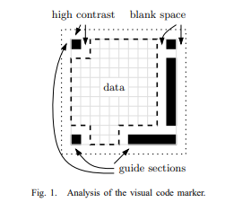
This border serves the same purpose as the border around barcodes and ensures that the marker is separate from any background it is placed on. The image source is a digital image from a camera equipped cell phone. The image is of VGA resolution (640 × 480) and provided as a compressed 8-bit RGB JPEG file. The compression ratio is approximately 18:1. This resolution is comparatively low but it is of course definately adequate to sample and extract the data from the markers under the right conditions. Of more importance are the conditions under which the image is obtained. Specifically, the camera is most likely to be handheld, leading to a degree of motion blur, and to be positioned somewhat haphazardly, leading to arbitrary transformations in angle, translation and perspective. Furthermore, the lighting conditions are not controlled and it is possible that the illumination will not be constant over the image and definately not between images. The high contrast between the binary elements (black vs. white) will help to differentiate the binary values under a wide range of lighting conditions. The marker is likely to be a small fraction of the total image data. It is expected that the marker will be approximately between 100 × 100 and 150 × 150 pixels. As part of the project brief the image may contain one to three markers in an image. 1.2. Aim To Resize and Rotate the given image.

Slide 6
1.3. Examples of Fields that Use Digital Image Processing Today, there is almost no area of technical endeavor that is not impacted in some way by digital image processing. We can cover only a few of these applications in the context and space of the current discussion. However, limited as it is, the material presented in this section will leave no doubt in your mind regarding the breadth and importance of digital image processing. We show in this section numerous areas of application, each of which routinely utilizes the digital image processing techniques developed in the following chapters. Many of the images shown in this section are used later in one or more of the examples given in the book. Most images shown are digital images. The areas of application of digital image processing are so varied that some form of organization is desirable in attempting to capture the breadth of this field. One of the simplest ways to develop a basic understanding of the extent of image processing applications is to categorize images according to their source (e.g., X-ray, visual, infrared, and so on).The principal energy source for images in use today is the electromagnetic energy spectrum. Other important sources of energy include acoustic, ultrasonic, and electronic (in the form of electron beams used in electron microscopy). Synthetic images, used for modeling and visualization, are generated by computer. In this section we will discuss briefly how images are generated in these various categories, and the areas in which they are applied. Images based on radiation from the EM spectrum are the most familiar, especially images in the X-ray and visual bands of the spectrum. Electromagnetic waves can be conceptualized as propagating sinusoidal waves of varying wavelengths, or they can be thought of as a stream of massless particles, each traveling in a wavelike pattern and moving at the speed of light. Each massless particle contains a certain amount (or bundle) of energy. Each bundle of energy is called a photon.

Slide 7

If spectral bands are grouped according to energy per photon, we obtain the spectrum shown in Energy of one photon (electron volts), ranging from gamma rays (highest energy) at one end to radio waves (lowest energy) at the other. The bands are shown shaded to convey the fact that bands of the EM spectrum are not distinct, but rather transition smoothly from one to the other. 1.4. Fundamental Steps in Digital Image Processing It is helpful to divide the material covered in the following chapters into the two broad categories defined in methods whose input and output are images, and methods whose inputs may be images, but whose outputs are attributes extracted from those images. This organization is summarized . The diagram does not imply that every process is applied to an image. Rather, the intention is to convey an idea of all the methodologies that can be applied to images for different purposes, and possibly with different objectives. Image acquisition is the first process . The discussion in Section gave some hints regarding the origin of digital images. where we also introduce a number of basic digital image concepts that are used throughout the book. Acquisition could be as simple as being given an image that is already in digital form. Generally, the image acquisition stage involves preprocessing, such as scaling. Image enhancement is the process of manipulating an image so the result is more suitable than the original for a specific application. The word specific is important here, because it establishes at the outset that enhancement techniques are problem oriented.

Slide 8
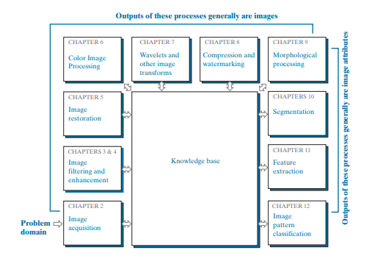
Thus, for example, a method that is quite useful for enhancing X-ray images may not be the best approach for enhancing satellite images taken in the infrared band of the electromagnetic spectrum. 1.5. Components of an Image Processing System As recently as the mid-1980s, numerous models of image processing systems being sold throughout the world were rather substantial peripheral devices that attached to equally substantial host computers. Late in the 1980s and early in the 1990s, the market shifted to image processing hardware in the form of single boards designed to be compatible with industry standard buses and to fit into engineering workstation cabinets and personal computers. In the late 1990s and early 2000s, a new class of add-on boards, called graphics processing units (GPUs) were introduced for work on 3-D applications, such as games and other 3-D graphics applications. It was not long before GPUs found their way into image processing applications involving large-scale matrix implementations, such as training deep convolutional networks.

Slide 9
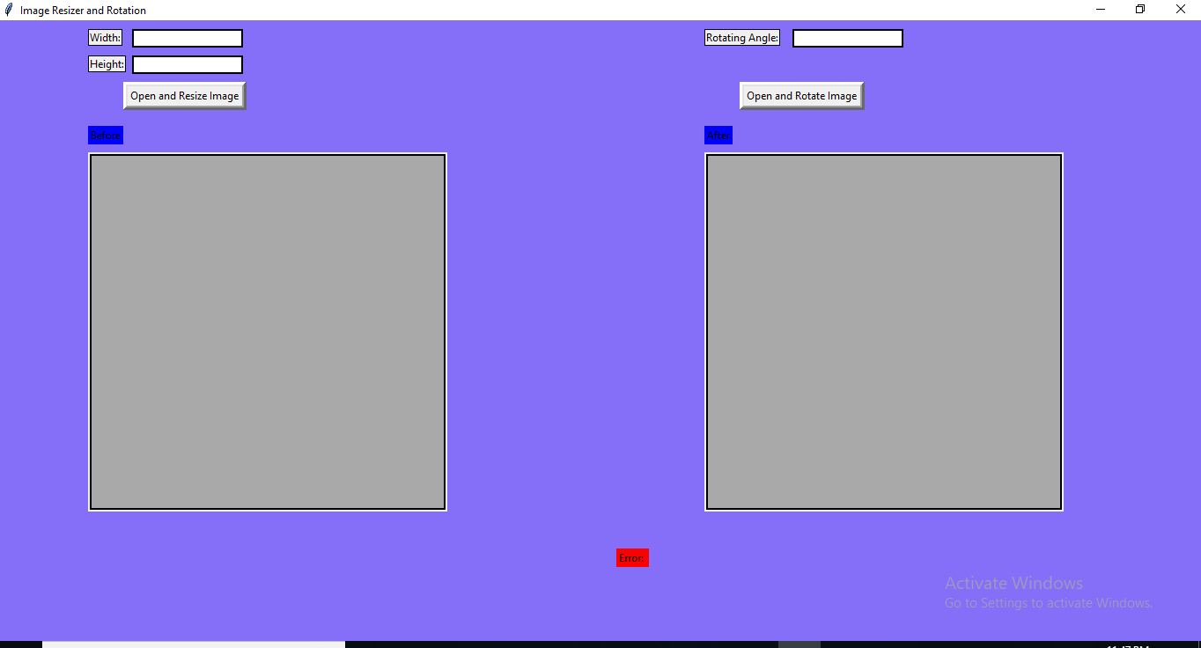
In addition to lowering costs, the market shift from substantial peripheral devices to add-on processing boards also served as a catalyst for a significant number of new companies specializing in the development of software written specifically for image processing. 2. Interfaces A point of connect between entities working on a common project. 2.1. User Interfaces The user interfaces will be an GUI window . the window will appear after executing the program and used whenever it wants . The prototype interface is the following :-

Slide 10
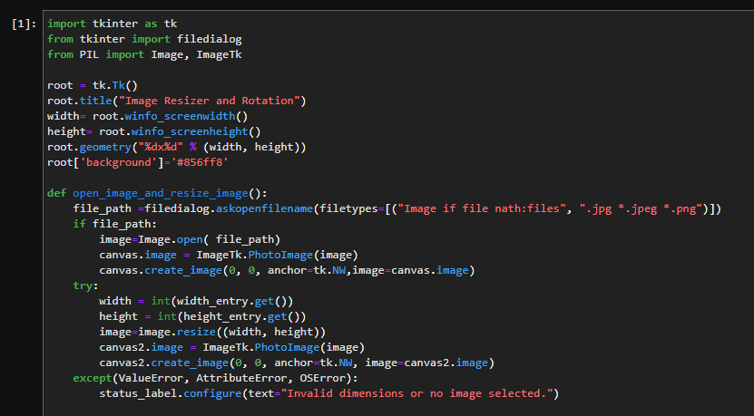
2.2. Hardware Interfaces Not applicable. 2.3. Software Interfaces The system will use High - definition Photo for Image Processing. 2.4 Communications Interfaces The only communication is between the program and the server. 3. Code

Slide 11
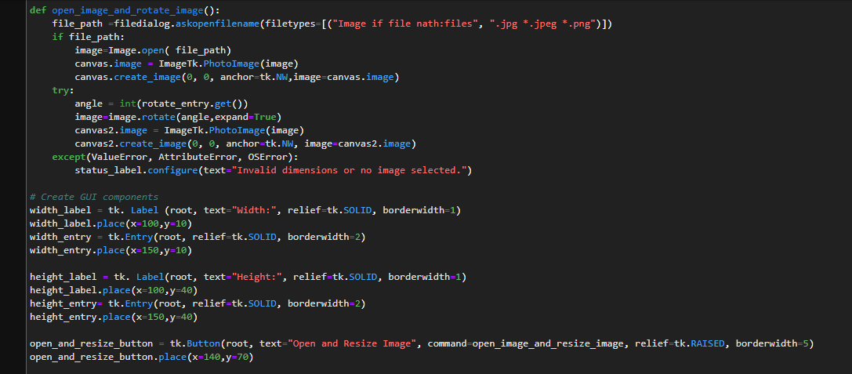
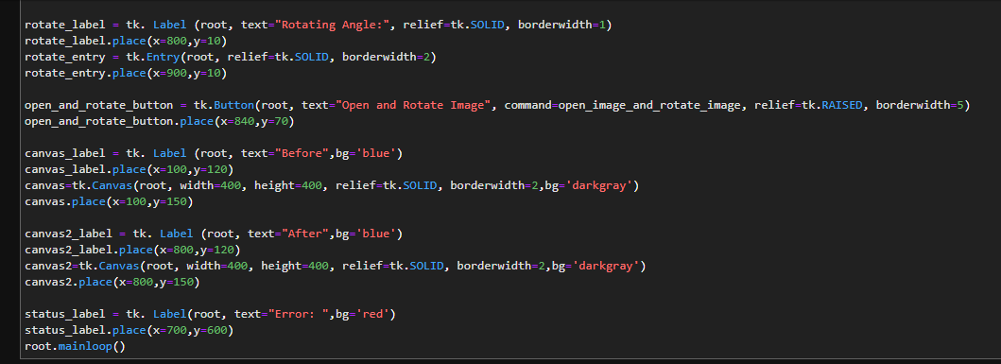

Slide 12
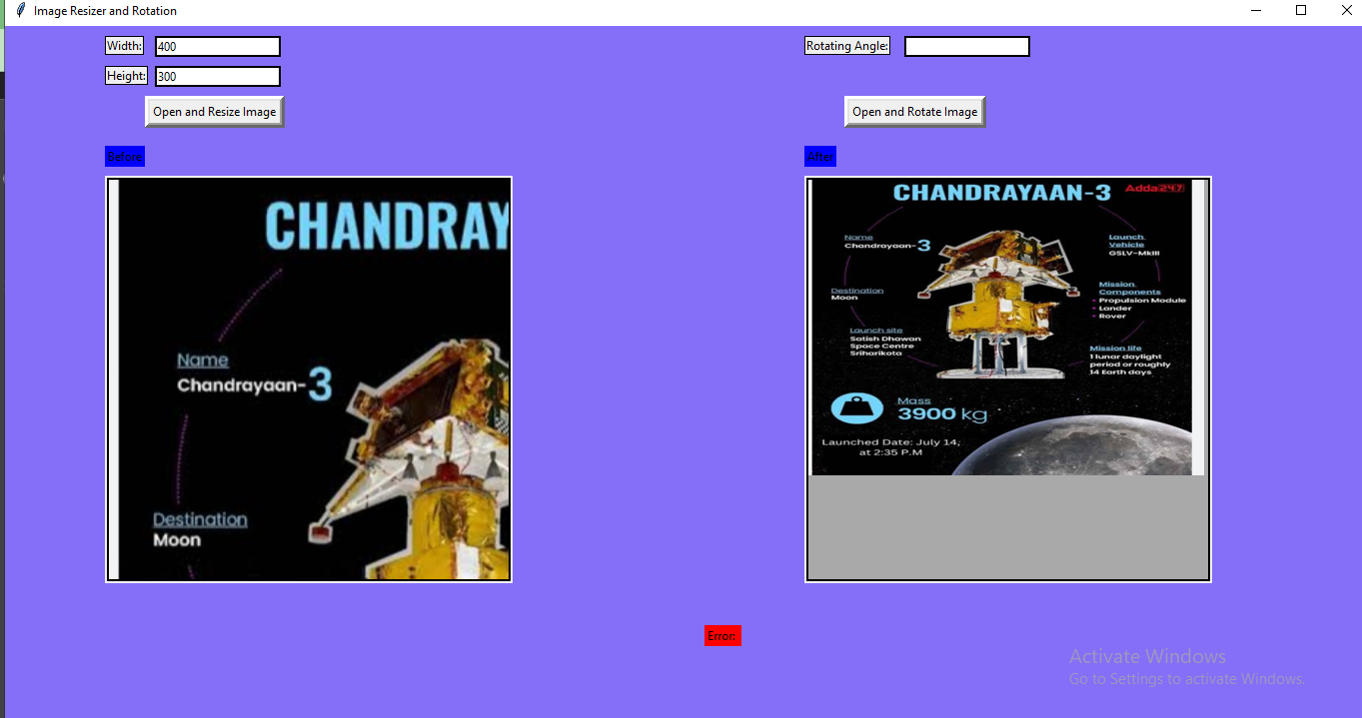
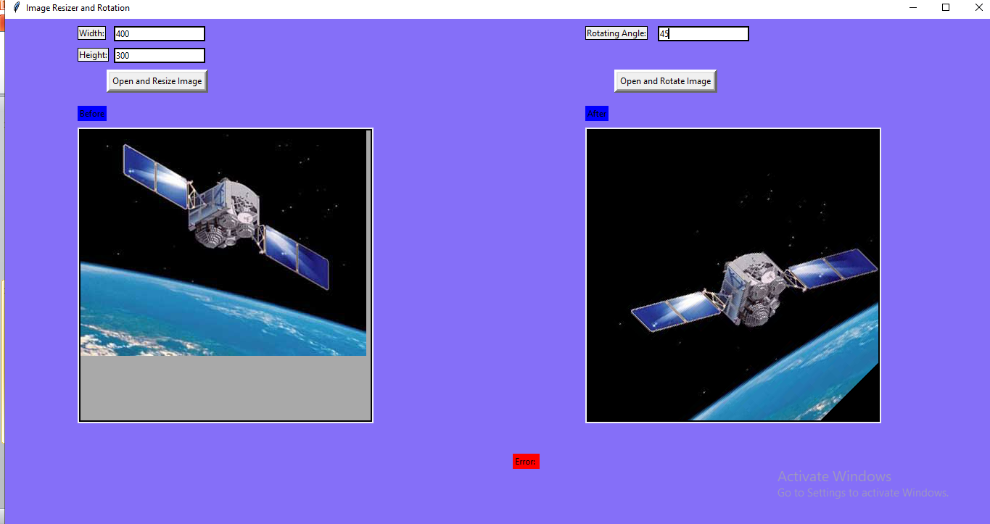
4. ScreenShots Resize Rotate

Slide 13
5. Conclusion and Future Directions * Improved Image Quality : ML-based image resizers can retain image quality while reducing size. * Optimized Loading Times : Faster-loading web pages and applications lead to improved user engagement and reduced bounce rates. * Bandwidth Savings : Reduced image file sizes save on bandwidth costs for website owners and benefit users with limited data plans. * Cross-Platform Compatibility : ML-based resizers can adapt images for various devices and screen sizes. * Future Potential : As machine learning continues to advance, these resizers can adapt and improve.

